Slide 1
William M. Singletary, MD wsingletarymd@gmail.com
Analytic Treatment and ASD:
A Journey to Love – Part 1 An Integrative Model of Autism Spectrum Disorder
5th Annual Jerome S. Blackman, MD
Lectureship in Psychoanalysis
Eastern Virginia Medical School Department of Psychiatry & Behavioral Sciences
and
The Virginia Psychoanalytic Society
October 20, 2023

Slide 2
ANNI BERGMAN
1918 - 1921

Slide 4
ANNI’S THERAPEUTIC WISDOM
Anyone can be helped
Everything has a meaning
Therapeutic task-making sense out of nonsense

Slide 5
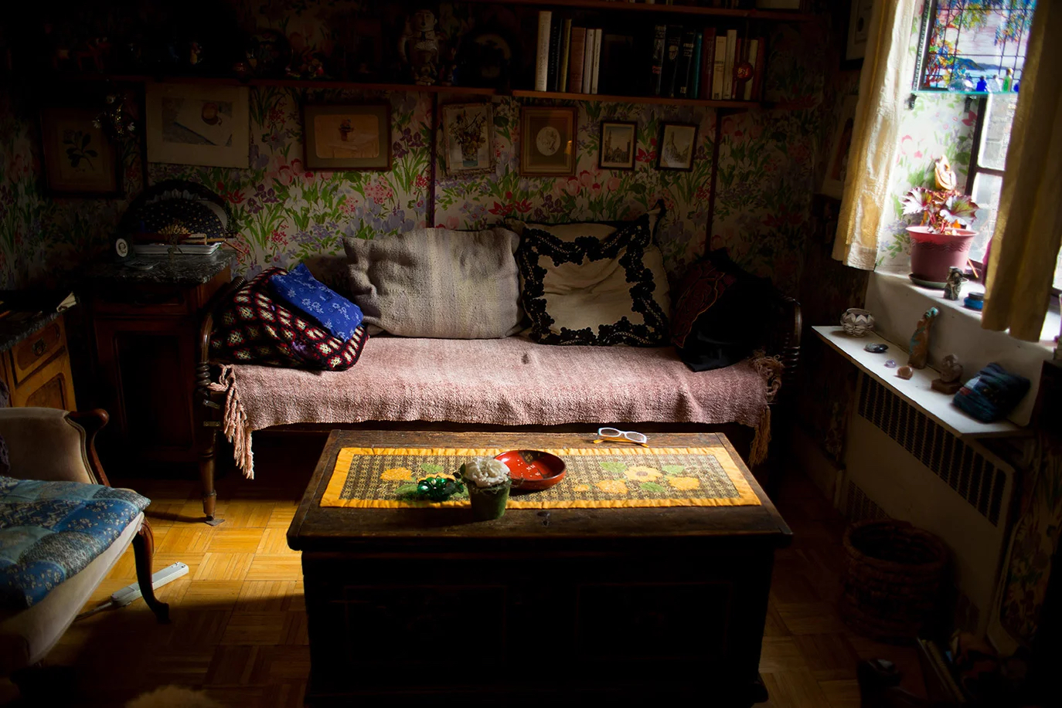

Slide 6
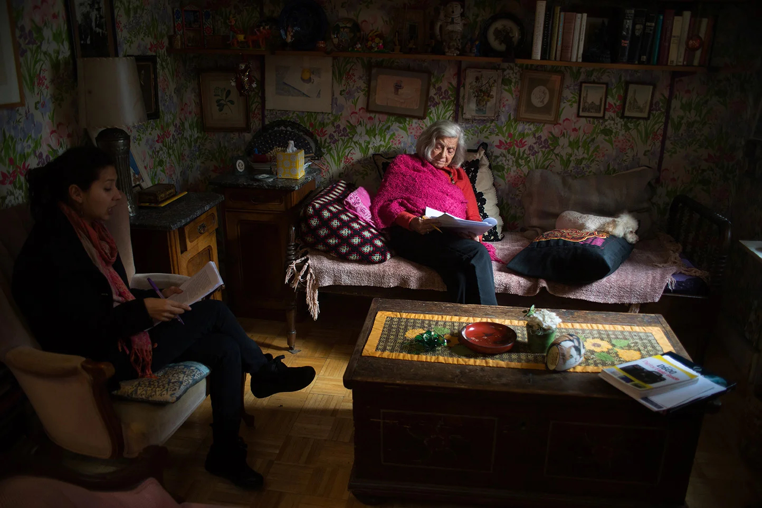

Slide 7
CENTRAL FACTOR
Emphasized the power of the relationship and that developing a sense of trust, safety and a loving connection with the therapist is a major factor
Providing therapy for children who live with wild things is a difficult, long-term process requiring tremendous patience and tenacity (Bergman, 2008, p. 219)

Slide 8
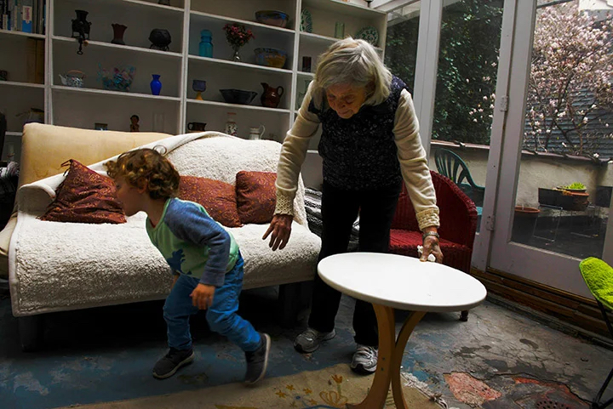

Slide 9
Legacy
Great love, kindness, and generosity
Energy, courage and determination
My image of her taking chances, trusting, and reaching out into the unknown
Inspiration-brought out the best in all who knew her

Slide 10
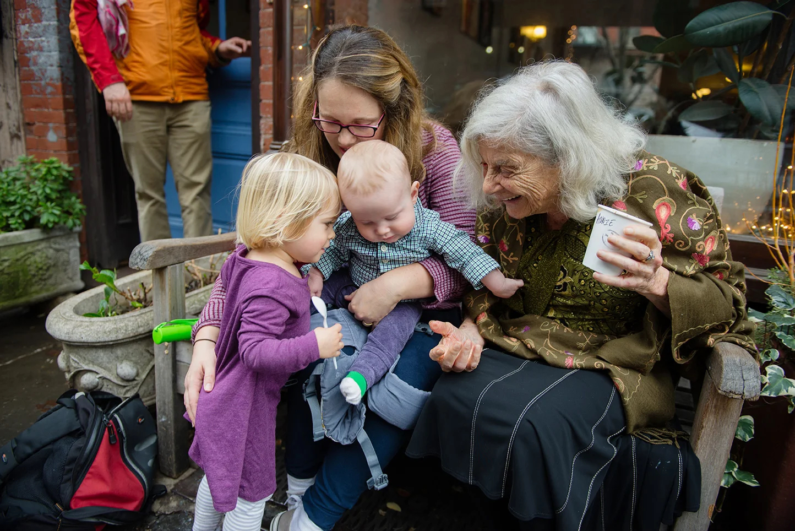

Slide 12
The Power of the Relationship
Aloneness
Transformation
Loving Connections

Slide 13
THE POWER OF THE RELATIONSHIP
VIDEO GOES HERE

Slide 14
The Power of the Relationship
Aloneness
Transformation
Loving Connections

Slide 15
ANNI BERGMAN
1918 - 1921

Slide 16
ASD and the Human Condition
Tustin-autistic children are in the grip of elemental terrors which are part of all of us
How to maintain human connectedness in the face of loss and death

Slide 17
Differences in the Treatment of ASD-1
Neurobiological vulnerabilities interfere with the functioning of the social brain and the sense of connectedness and safety

Slide 18
Differences in the Treatment of ASD-2
Danger and disconnection occur so early in life
Evolutionarily prepared biological and psychological protective responses to threat become stabilized and more difficult to reverse

Slide 19
Prenatal Stress and ASD
Prenatal exposure to hurricanes and tropical storms and increased risk of ASD (Kinney, et al.,2008)
Mothers exposed to childhood abuse and increased risk of ASD (Roberts, et al., 2013)

Slide 20
Vicious Circle Leading to ASD
Neurobiological and psychological factors
Protective and self-regulating efforts
Shut out parents’ love and help
Interfere with the development of the social brain and
Lead to the syndrome of ASD as well as
The resistance to change

Slide 21
Divergent Theories of ASD
Genetic / Epigenetic
ASD
Environmental / General Biological
ASD
Neuroanatomy
ASD
Neuromodulators / Neurotransmitters
ASD
Neutral Networks / Connectivity
ASD
Sensory Processing
ASD

Slide 22
Convergence - Final Common Pathway(s) to ASD
Heterogeneous Biological Factors
Disruption of Adaptive Social Behavior / Social Engagement
ASD

Slide 23
Notes:
Here Larry depicts the emotional prison which he has created for himself with his blocking out love, people, and food through the use of his various weapons which surround his cell. Over time, he comes to realize that through his unrealistic fears and attacks on helping people, his mind is actually tricking and imprisoning him. His wall actually shuts out what he needs the most and makes him miserable.

Slide 24
You may think Love is leaving you, but it’s not.

Slide 25
Emotional and Allostatic Overload Model
Too Much Stress

Slide 26
Pathway of Progression to ASD
Neurobiological Factors-Processes
Maladaptive Coping & Neuroplasticity
ASD
Biological Stress - Allostatic Overload
Environmental Deprivation
Psychological Stress-Toxic

Slide 27
Pathway of Alleviation of ASD
Interventions Targeting Multiple Factors
Neurobiological Factors - Processes
Adaptive Coping & Neuroplasticity
Alleviate ASD
Diminish Allostatic Load
Environmental Enrichment
Diminish Psychological Stress

Slide 28
Psychoanalysis as a Research Tool

Slide 29
Giving Up Shell Brings Fear of Death
Maladaptive responses feel essential to survival
Therapeutic change and connection mean vulnerability, loss, and death

Slide 30
Psychological Aspects of
Treatment and Parenting
Active engagement in relationships with parents and therapists (Greenspan and Weider, 2006)
Shared focus and attention along with non-verbal back and forth communication before
Talking and playing about the child’s inner world
Fears of connectedness (giving up autistic shell)
Fears of change, loss, and death

Slide 31
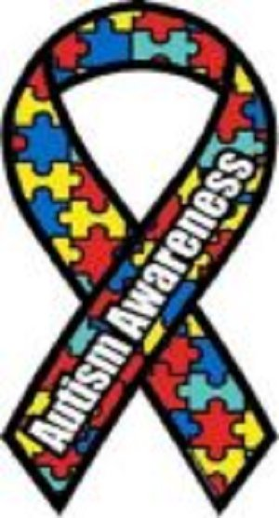
The Puzzling World of the
Child with Asperger's
The Missing Piece

Slide 32
Hidden so, so deep in the heart of children lies the fear of death.
-Eight year-old boy in treatment
Notes:
After Hoffer talk about ambivalence and sad and not mad-the decision field-

Slide 33
My world has a wall to block sadness.

Slide 34
People are waste in my world.

Slide 35
I shred love in my world.

Slide 36
We burn the things we need.

Slide 37
Control or die.

Slide 38
When the little me tricks.

Slide 39
Neuroplasticity
Hebb's Law:
Neurons that fire together, wire together
“Cascading constraints”- Lewis, 2005

Slide 40
Maladaptive Neuroplasticity in ASD
Neurobiological Factors
Impaired Relationships
Increased Stress
Interfere with
Brain Development

Slide 41
The bad peeps stairs.

Slide 42
Adaptive Neuroplasticity in ASD
Normalize Brain Development
Improved Relationships and Use of Treatment
Remove Psychological Obstructions
Understanding Inner Experience

Slide 43
Improvement stairs.

Slide 44
I fix my mind.

Slide 45
Focus of Treatment
Alone
in a
Threatening World
Transformation
Loving Connections
and
Sense of Safety

Slide 46
Love and the Hermit Crab.

Slide 47
You do not need things.

Slide 48
Team 1 and Team 2.

Slide 49
Bridge.

Slide 50
Ultimate Goal:
"Lunchbox for Love"
Safety through memories of loving and protective parents

Slide 51
You may think Love is leaving you, but it’s not.

Slide 52
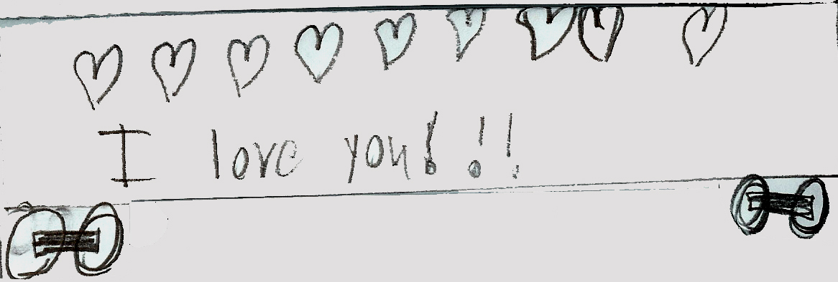
Notes:
Through this process which involves the child choices and effort, he builds a strong internal structure-a strong self along with real self-esteem. Two days ago, Larry used some toy cars which can be taken apart and put back together to demonstrate how he feels like he’s really changed. He began choosing a car to represent himself and took it completely apart and talked about how it was broken down and represented how he was at the beginning of treatment. He put the basics back together and said that this was getting him and the car back in working order. Then with the process of continuing to upgrade this basic working car. He he put on a new hood and said this was like putting on a new face so that it would look better. Before he used to go around looking angry all the time. Then he put on new doors and said that this is how I can help people see me in a better way. He added side skirts and a rear spoiler to help himself stay focused and in balance. He would only talk about as you get older you can change more and he put on a new front body kit. He then put on the wheels he said to keep me going so I don’t stop. He said this is like me, how I am in the in-it looks completely different is a lot cooler. He added, our job is to write a book that helps other people help other children with autism you even serious autism. He went on to take some other cars and then went through a similar process. At the end of our session, he wanted me to share this with his mother.

Slide 53
Team 1 and Team 2.

Slide 54
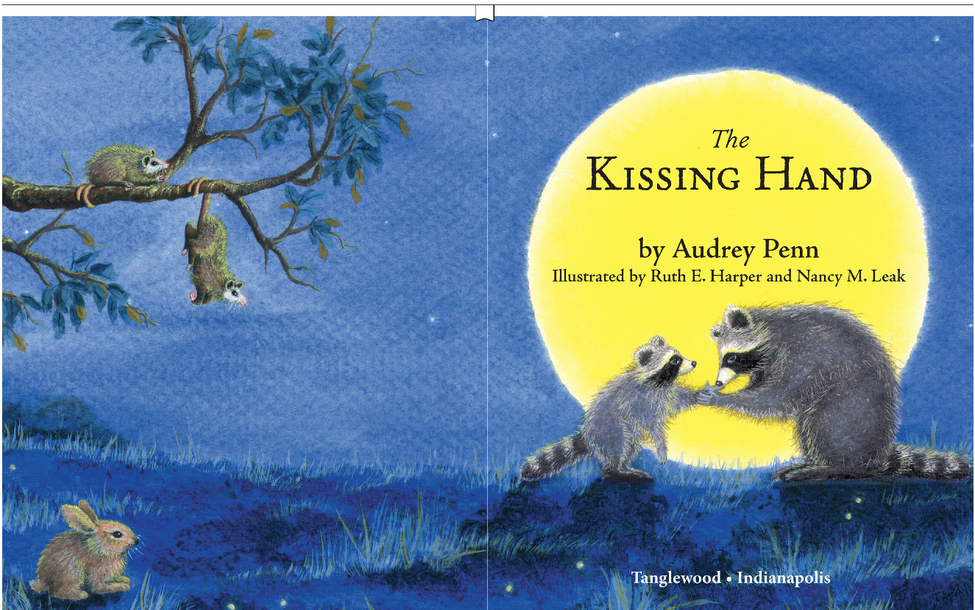

Slide 55
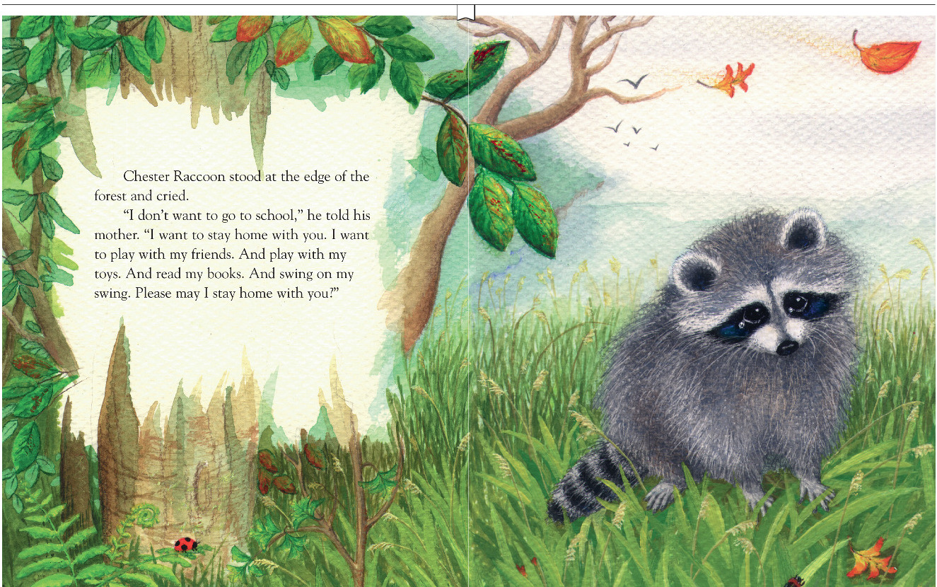

Slide 56
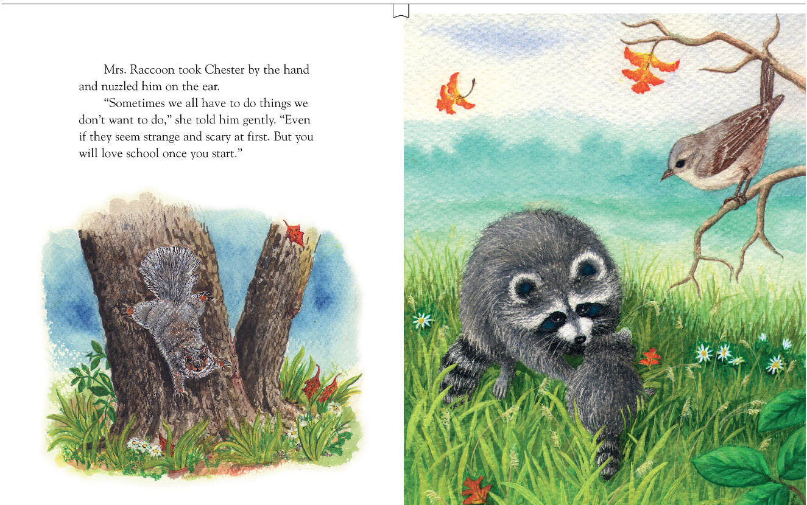

Slide 57
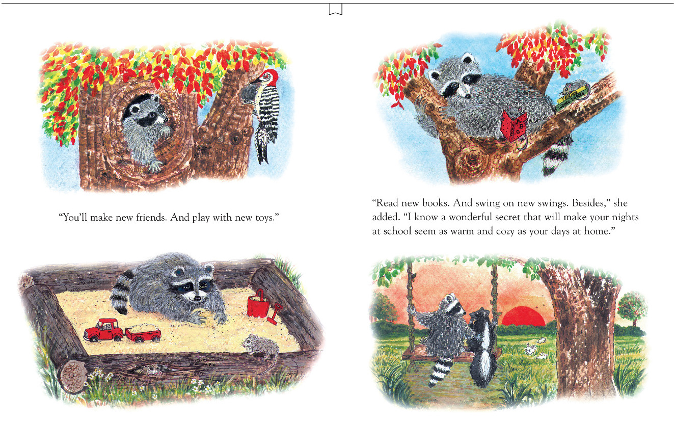

Slide 58
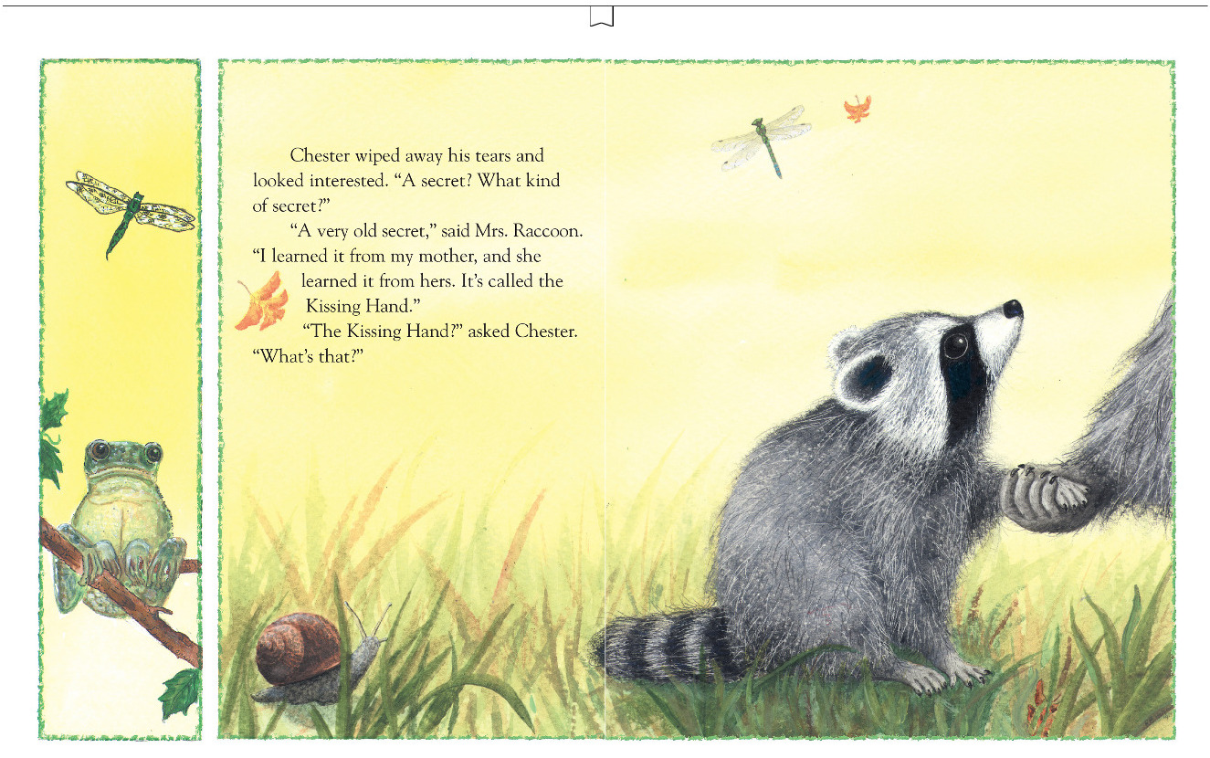

Slide 59
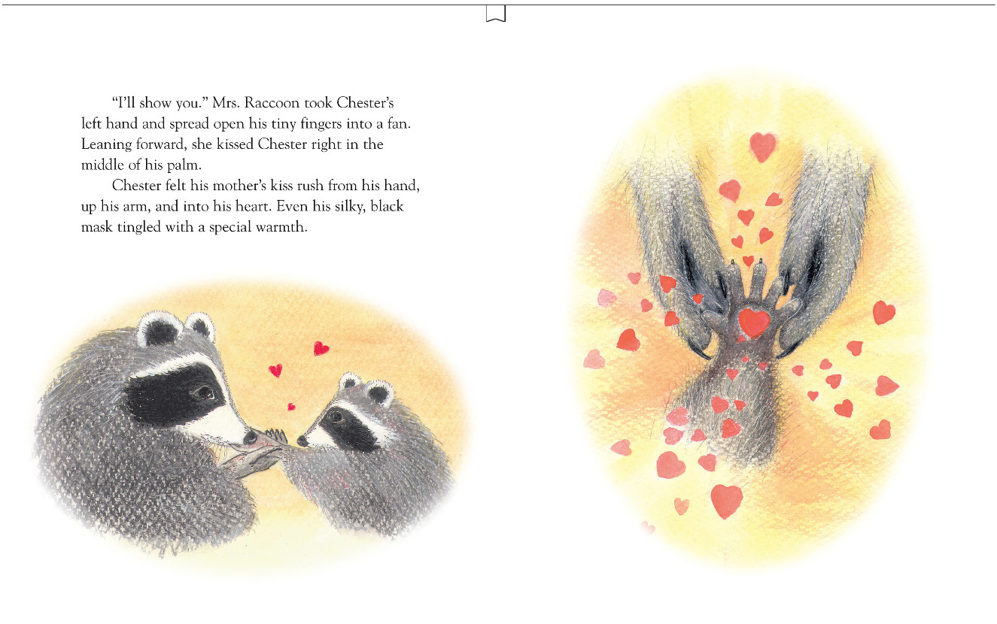

Slide 60
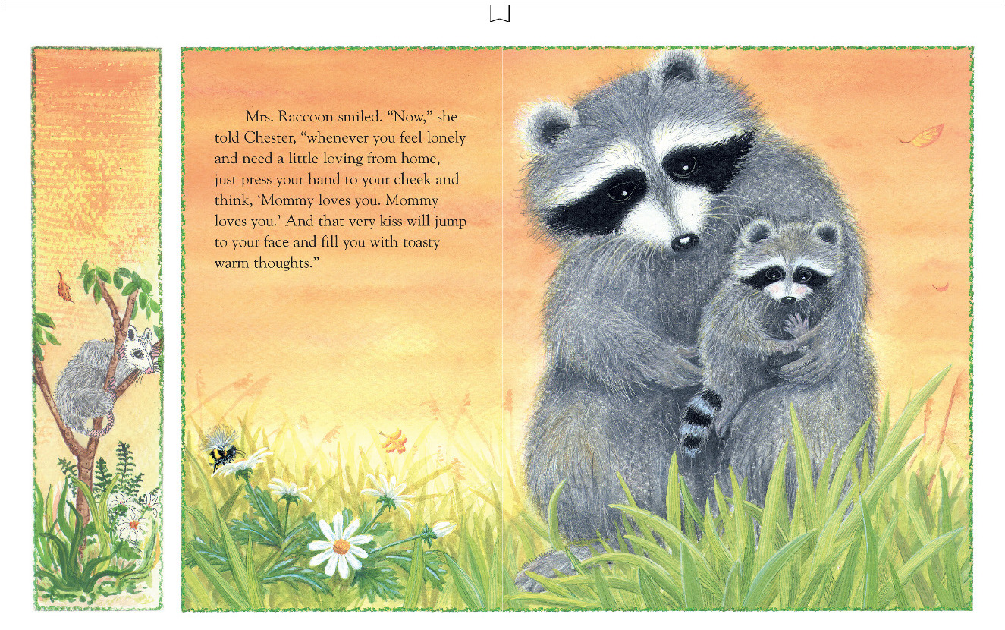

Slide 61
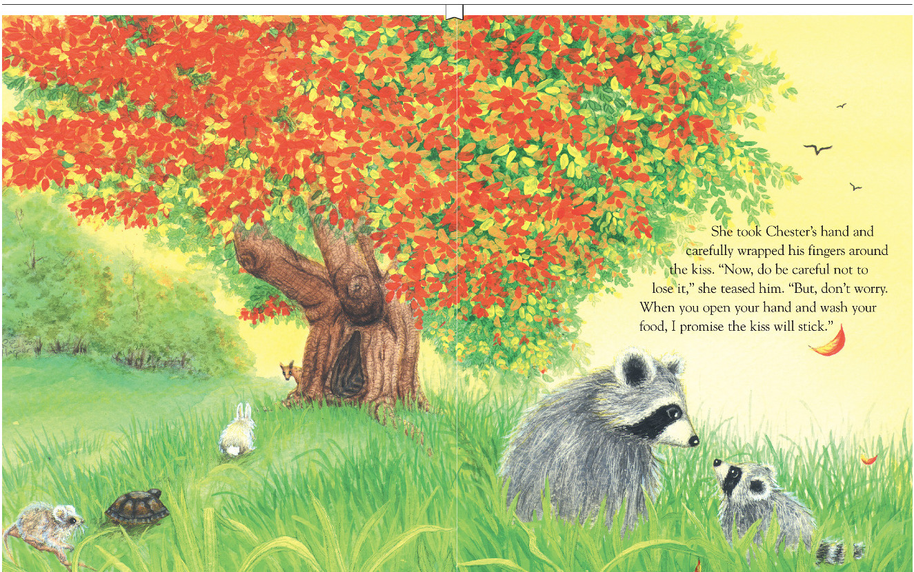

Slide 62
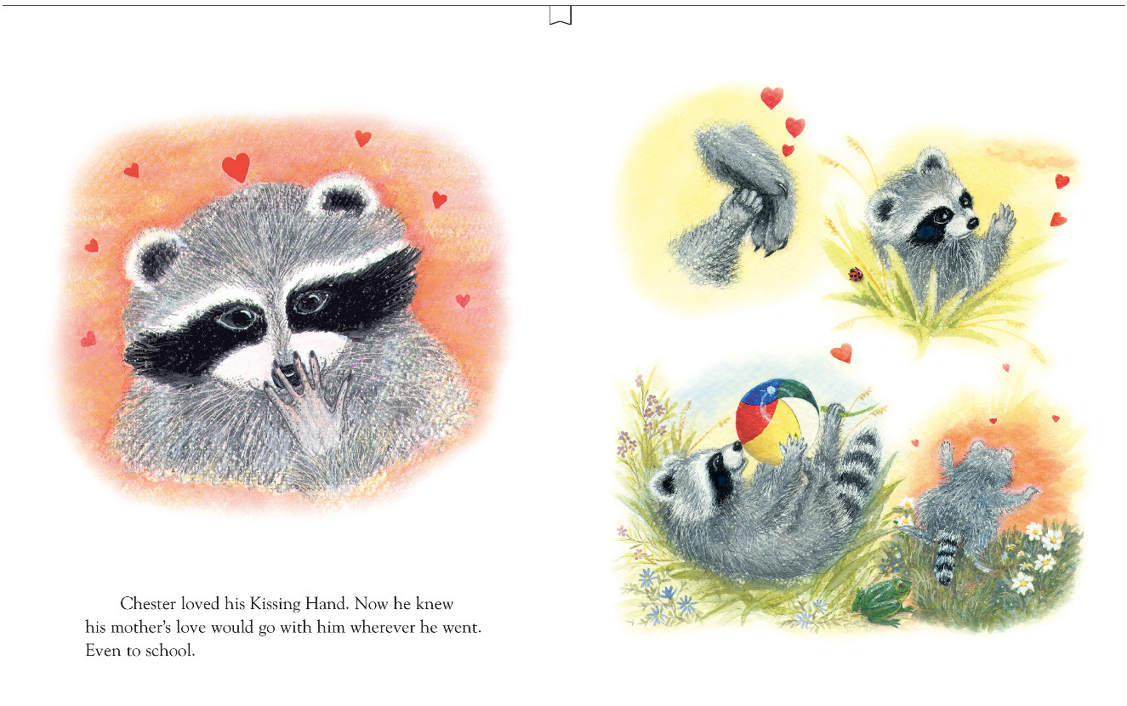

Slide 63
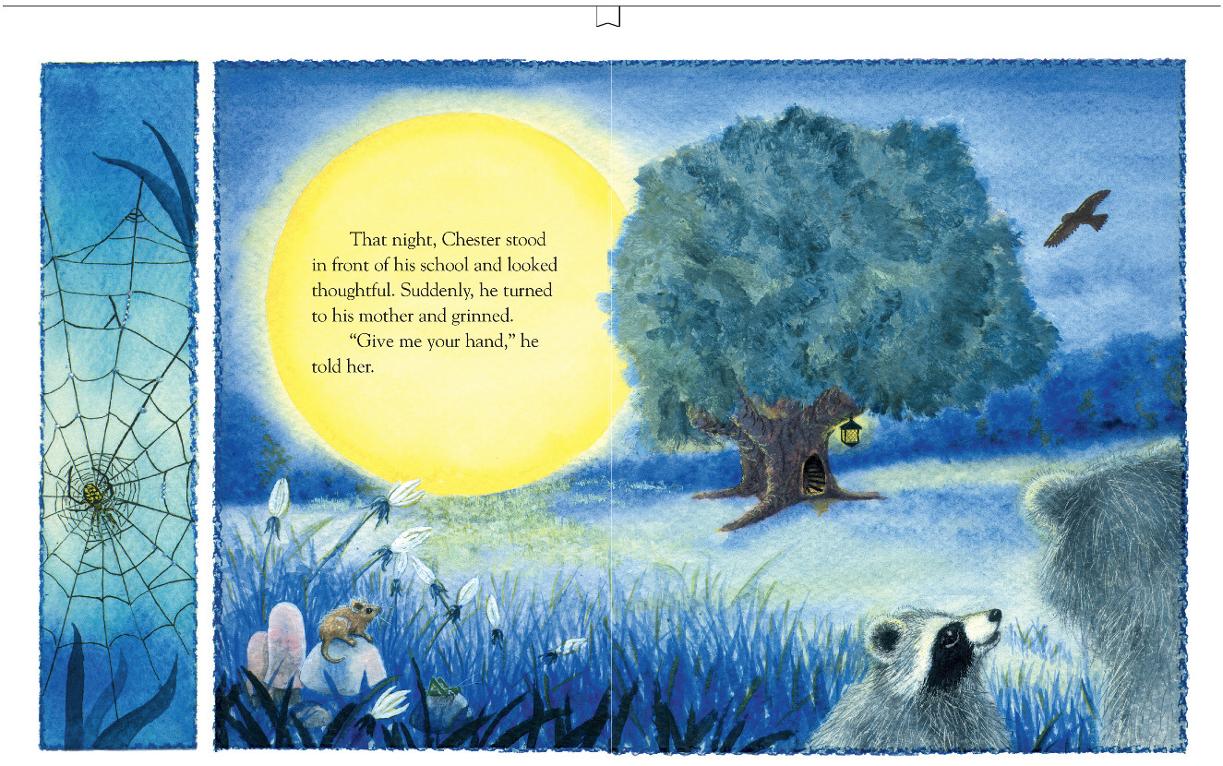

Slide 64
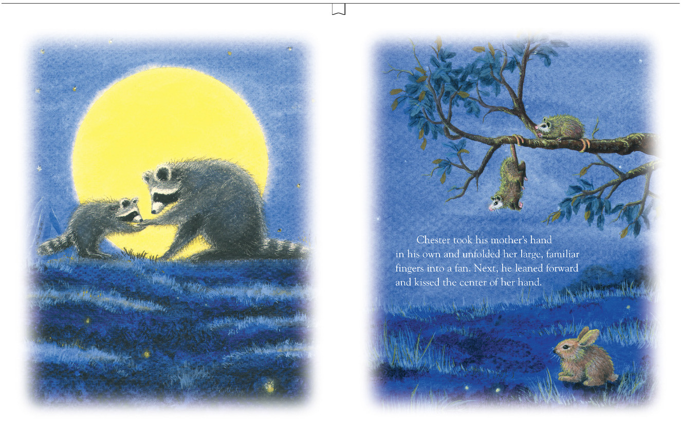

Slide 65
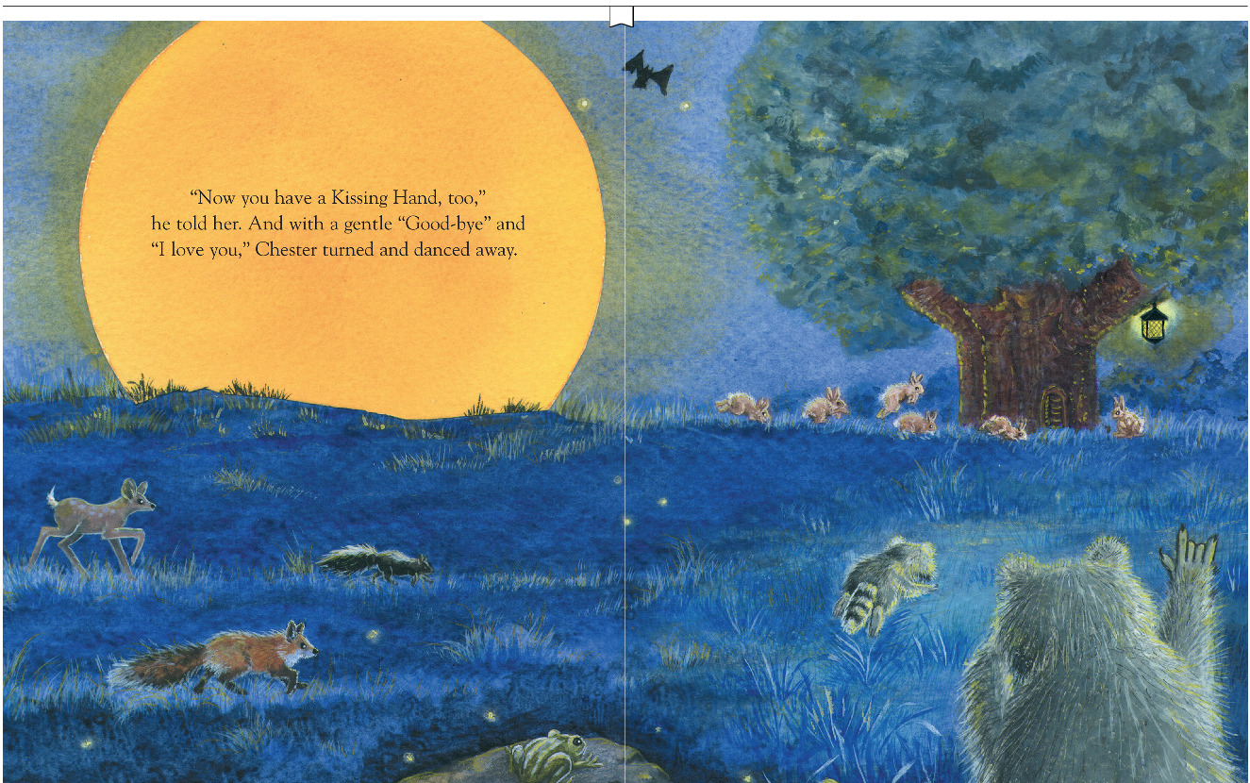

Slide 66
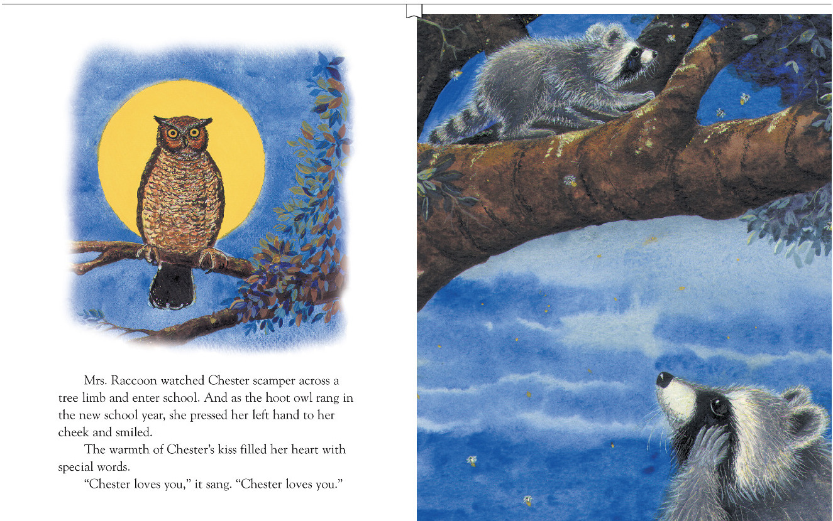

Slide 67
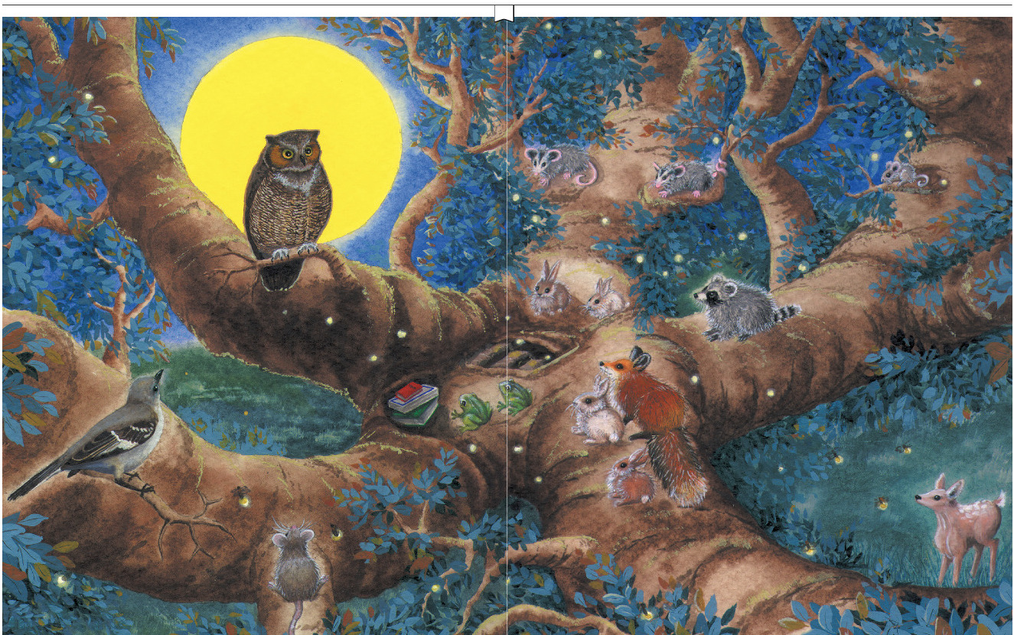

Slide 68
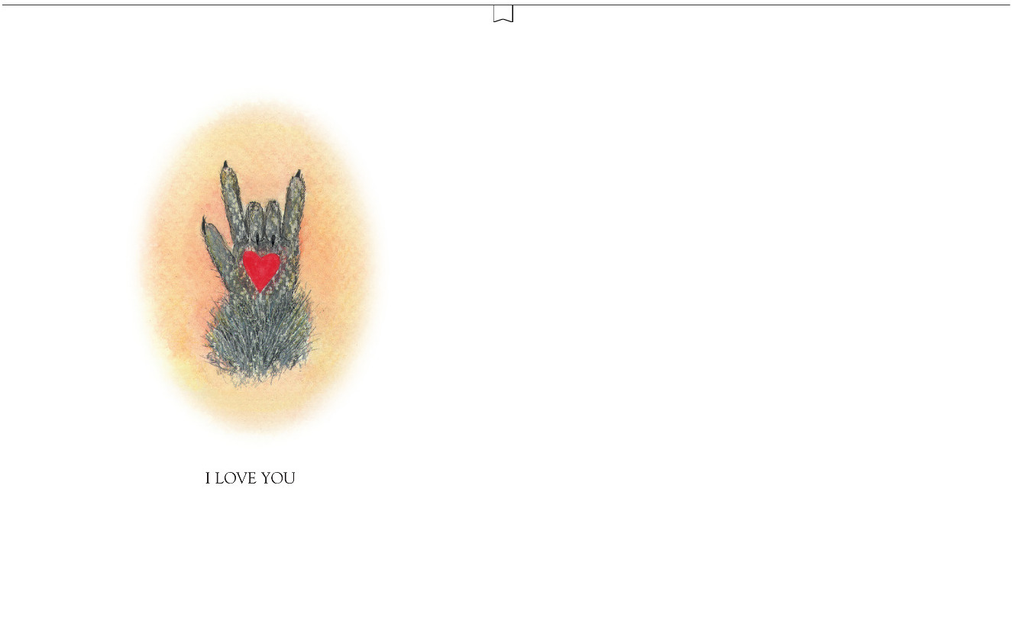

Slide 69
DEFINITION OF OBJECT
CONSTANCY
The object is longed for, and not rejected (hated) as unsatisfactory simply because it is absent.
-Hoffer (1955)
Notes:
After Hoffer talk about ambivalence and sad and not mad-the decision field-

Slide 70
RELATIONSHIPS IN ASD
Object constancy
How to focus treatment

Slide 71
William M. Singletary, MD wsingletarymd@gmail.com
Analytic Treatment and ASD:
A Journey to Love – Part 1 An Integrative Model of Autism Spectrum Disorder
5th Annual Jerome S. Blackman, MD
Lectureship in Psychoanalysis
Eastern Virginia Medical School Department of Psychiatry & Behavioral Sciences
and
The Virginia Psychoanalytic Society
October 20, 2023

